Slide 1
November 2019 Fort Wayne VMUG
Infrastructure Testing With PowerShell & Pester

Slide 2

Who is this guy?
Bill Kindle – Systems Administrator
Contributor to The PowerShell Conference Book vol. 2
Guest Writer for AdamTheAutomator.com and Content Contributor at TechSnips.io
Is really into model railroading and trains
Father of two wonderful, sticky, little people who don’t pay rent.
Husband to a loving wife whom he’d be absolutely lost without.
Notes:
Shameless self promotion time!

Slide 3
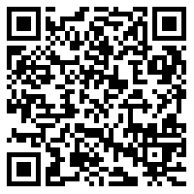
If you want to follow along, the code examples are available here.
SCAN ME!
git clone https://github.com/billkindle/FWVMUG_November_2019_Testing_Infrastructure_With_Pester.git

Slide 4

Story Time!
Notes:
In my current day job, I am in charge of maintenance cycles for some very small and very large environments.
I came to use Pester through experiencing a recurring problem; Having systems not be fully operational post maintenance cycle. Sometimes these issues would be immediately apparent, and sometimes they would take a few days to rear their ugly bits.
Each time this occurred, it was very frustrating not only for me, but for the internal support personnel and for the customer.
I needed a surefire way to verify the processes my scripts were performing, were doing precisely what they were supposed to do.
I needed to test services were started.
I needed to test that IIS application pools were running.
I needed to test that SQL clusters were online and available.
I needed to test websites for HTTP 200 responses.
Occasionally I needed to test if an particular KB was applied or not.
This was my scenario. Luckily, after some discussions with some very knowledgeable PowerShell guru’s, I was told about a secret weapon…..

Slide 5
Pester
The PowerShell Module for the Developer and EVERYDAY SysAdmin
Notes:
Introducing Pester! The dual purpose PowerShell module for Developers and the everyday SysAdmin.

Slide 6
What is Pester
?
?
?
Pester is a testing framework for PowerShell code.
It’s a DSL (Domain Specific Language) with an easy to understand syntax
Comes built-in with Windows 10, Server 2016 and 2019
Works with CI/CD pipelines (Jenkins for example)
It isn’t just for testing PowerShell code, it can also be used for…
?
?
Notes:
Pester began as a testing framework for PowerShell developers. Other scripting languages had a testing framework, but in the bad old days PowerShell did not.
Based on Doman Specific Language, the syntax is easy to read. Human readable. Chances are you’ve used a few already.
HTML, CSS, SQL, XML to name a few are all DSL’s.
This module did great testing developer code, but it was soon found to have additional use cases where PowerShell was involved.
Testing Infrastructure!

Slide 7

Let’s Talk About Testing Infrastructure
Notes:
Yes, infrastructure.
Testing infrastructure is something we as SysAdmins have been doing without even realizing it at times. We troubleshoot, diagnose, repair, test.
We Use Windows.
We Use Linux.
We Use MacOS.
We Use Hyper-V ☺……nested inside a guest VM on a ESXi host in a Vmware vSphere cluster!
We have a common language to administer it all. PowerShell.

Slide 8
Why Testing is Important
Human Error
Money / Time
Right Thing To Do
Notes:
To err is to be Human.
I have made and still make mistakes in my code. I’ve applied the wrong settings and parameters to systems. I’ve had the conversations where I’ve had to admit I goofed up.
In some / most cases, not testing can result in loss of time and money. Not testing something that can result in that could be an RGE. Testing may prevent an RGE!
This makes me very appreciative of testing, especially with Pester.

Slide 9

We Have Checklists…
Notes:
We already have (or should have) checklists for various daily operations. These checklists can be for configuring a server, workstation or even a network device.

Slide 10
Pester Testing Quick Start
What you need to know Right now

Slide 11

How to Get This Module
PS> Install-Module -Name ‘Pester’
PS> Save-Module -Name ‘Pester’ -Path ‘.\’
PS> Update-Module -Name ‘Pester’
Notes:
If you have Windows 10 and PowerShell 5.1 or higher, you shouldn’t have to install the module. It should already be present. However, you can save the module or update the module to the most current release.
If you save the module you can manually copy it to the directory where you have configured your modules to reside or the defaults. Choice is yours.
The module is updated regularly so I strongly suggest using the latest version at all times.

Slide 12
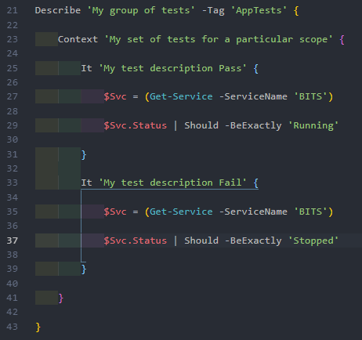
Basic Syntax & Structure
Describe Block
Context Block
Assertion Block
Assertion Block
Notes:
Lets talk about the basic structure of a pester test.
We have three basic blocks here to remember. Describe (a logical grouping), Context (scope within the group), and an Assertion (your test, what ‘It’ should be or shouldn’t be). You can skip context but it’s good if you like to be organized.
I like to keep my testing as simple as possible, and one thing that helped me in creating tests that I use is to get a single value using PowerShell code to represent the expected or unexpected state returned.
For example, I test for service availability after a maintenance cycle. So I create a bit of code to test that service and return only the object property that I need. In example here on the slide, I’m testing the same service but with different expectations. You may notice the tests are for pass and fail. More on this in a moment.
I set $SVC to get the service I’m looking for, then I drill down using type data. In this case using $SVC.Status gives me only the status property.

Slide 13
Asserting The Expected State
What’s Expected= [+] /Green / Pass / Good
Not What’s Expected = [-] / Red / Fail / Bad
Notes:
Assertions are just that. Assertions.
What should be or what shouldn’t be. Those are your tests!
One thing to remember is to think about your test and it’s expected state. Using Boolean terminology (true / false), ask yourself when writing an It statement what the expected end state is. Should a service be running or stopped?
If you expect running, make sure to put this in the –Name property string to explicitly state so, then write your code to get the state, using the Should properties to designate the expected state.
If you were to use Should –NotBe “Running” and your code returns a status of “Running”, the test fails. Change that to –Be or –BeExactly “Running” and the test passes.

Slide 14
Demo Time

Slide 15
CentOS 7.6
Pester running on Linux with PowerShell 7 preview 5
Notes:
Just a quick demonstration of a basic test that is run on a Linux host out in Digital Ocean. I’m using the latest PowerShell version available at the time of this presentation. Preview 6 is dropping very soon.

Slide 17
Testing Domain Controllers
A complete Solution Running Pester tests on network
From a Windows 10 management Workstation
Notes:
In this demo, I’m going show you a test that I collaborated on that crawls your domain and can automatically run tests you would see with repadmin. This demo may be a little slower than it would be in a real environment.

Slide 19
Sample Infrastructure Test
Real world example used in production, redacted of course!
Notes:
Here I’m going to show you an actual infrastructure test I perform quite often, redacted of course. However, it should give you an even clearer picture of just what you can do with Pester when it comes to testing your infrastructure changes being made with PowerShell and PowerCli.

Slide 21
Additional Information
Resources To help you learn more about PESTER
Notes:
https://www.red-gate.com/simple-talk/sysadmin/powershell/introduction-to-testing-your-powershell-code-with-pester/
A good URL to share later.

Slide 22

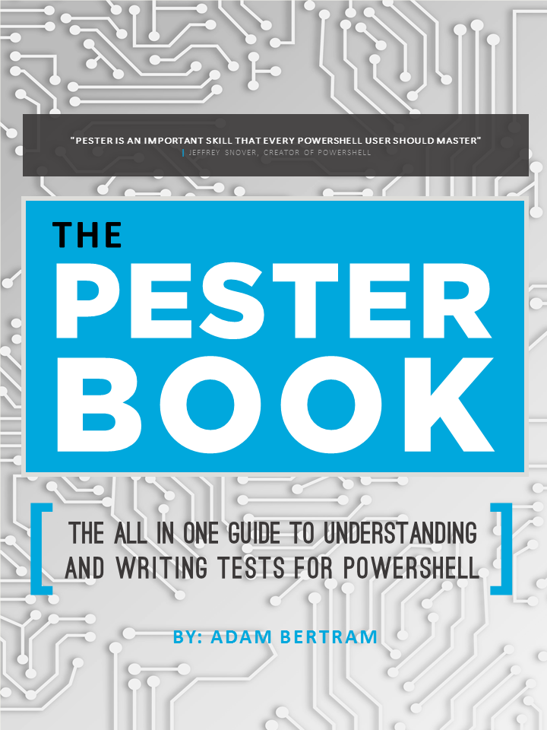
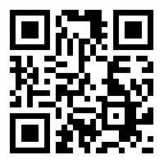
https://leanpub.com/pesterbook
SCAN ME!
Notes:
The Pester Book – an excellent and one of a kind reference book on all things Pester. Use the QR code to take a further look at the book at LeanPub.

Slide 23

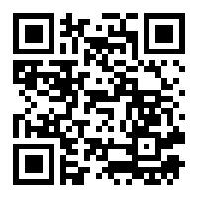
SCAN ME!
https://github.com/vexx32/PSKoans
Notes:
PSKoans is a module specifically designed to help teach PowerShell by doing and it uses Pester to measure progress. Scan the QR to visit the PSKoans GitHub repository.

Slide 24


Support the Developers of Pester
https://opencollective.com/pester
SCAN ME!
Notes:
If this module helps you solve a problem and enhances your PowerShell and PowerCli scripts, show some love for the many developers on the project by visiting this link.

Slide 25

Thank You!

